Slide 1


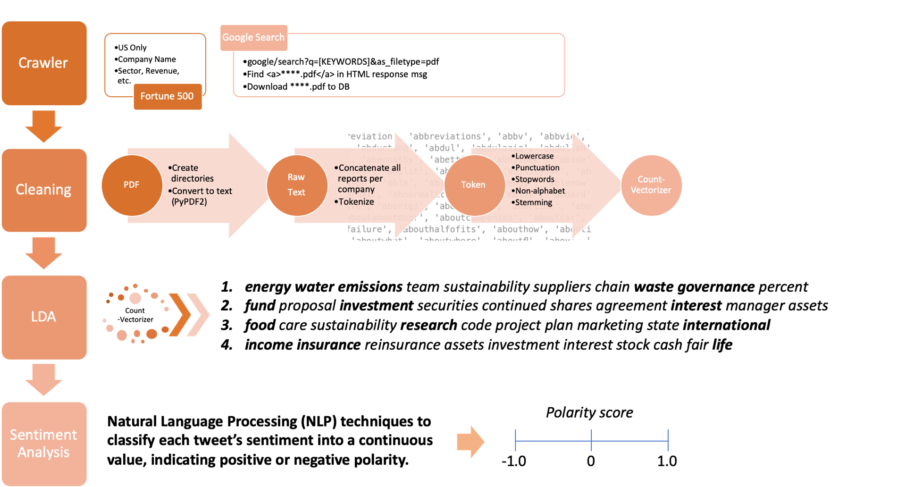
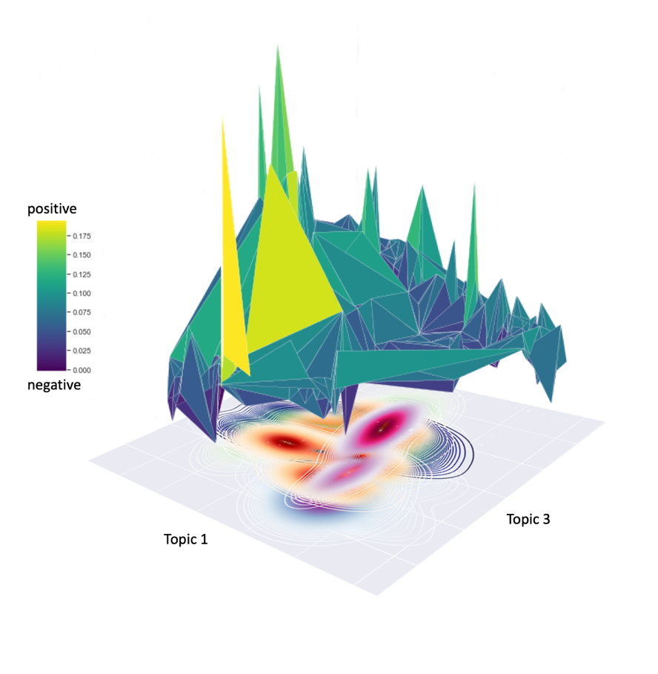
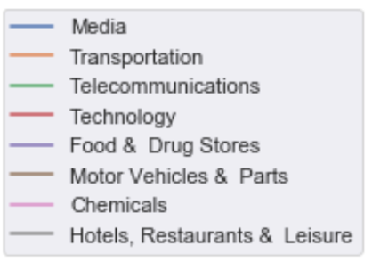
Social Corps (Corporate Social Responsibility)
Akshay Jagadeesh, Jee Su Byun, Dior Xiong, Zepeng Huo
INTRODUCTION
In an age where corporations are being scrutinized for their ethics, corporate social responsibility reports are on the rise. These reports show what the companies are trying to do ethically. We wanted to link this information to the public in order to find which companies were popular or not.
CSR Reports
METHOD
Create a crawler to find CSR.pdf
Clean corpora such as non-CSR contents
LDA to see the associated topics
Categorize companies under each topic
Use topic keywords to search tweets
Perform sentiment analysis
Visualize sentiment / sectoral analyses
PROJECT WORKFLOW
RESULTS
[1] Tremblay, M. C., Parra, C., & Castellanos, A. (2015, May). Analyzing Corporate Social Responsibility Reports Using Unsupervised and Supervised Text Data Mining. In International Conference on Design Science Research in Information Systems (pp. 439-446). Springer, Cham.
[2] Bollen, J., Mao, H., & Pepe, A. (2011, July). Modeling public mood and emotion: Twitter sentiment and socio-economic phenomena. In Fifth International AAAI Conference on Weblogs and Social Media.

